Slide 1

IED TM Lesson 1.4:
Threat Assessment Syndicate Exercise
Notes:
Find guidance inserted in the note section of each slide.

Slide 2

Terminal Learning Objectives
To exercise and consolidate the participants' knowledge and skills on threat assessment processes and mitigation techniques by means of map exercises and briefing.

Slide 3
Overview
1.4. Threat Assessment Exercise

Slide 4
Threat Assessment
Exercise

Slide 5
Training Objective and Methodology
To confirm the understanding of the threat assessment process and output. The aim is to highlight the threat triad and conduct an accurate threat assessment.
These exercises will be done by the participants in their syndicate groups.
Intent
Threat
Capability
Opportunity

Slide 6
Threat Assessment Exercise1
Situation.
You are a Search Team Commander working in an Infantry Company as part of the UN Mission in CARANA (UNMIC). Your company was deployed as part of a peacekeeping force to help respond to the instability caused by insurgent groups operating in CARANA seeking to overthrow the legitimate government. Your battalion is located in a Main Operating Base. Your Company in a Forward Operating Base (FOB) near a small village to provide local security.
In addition to normal vehicle patrols, the Company conducts regular foot patrols through the center of the village to reassure the population and deter the insurgent group form gaining popular support.
The patrols tend to take place in the morning before the heat of the day and they always use the route shown either clockwise or anti clockwise, normally stopping for a water break on route. The local population routinely use this same routes in the village area but they do not use the routes near the FOB area.
5 days ago there was an IED attack that hit one of your foot patrols killing one soldier and injuring one other.
From other incidents in the country the insurgents are believed to be capable of making both command IED (command wire only) and victim operated IEDs.

Slide 7
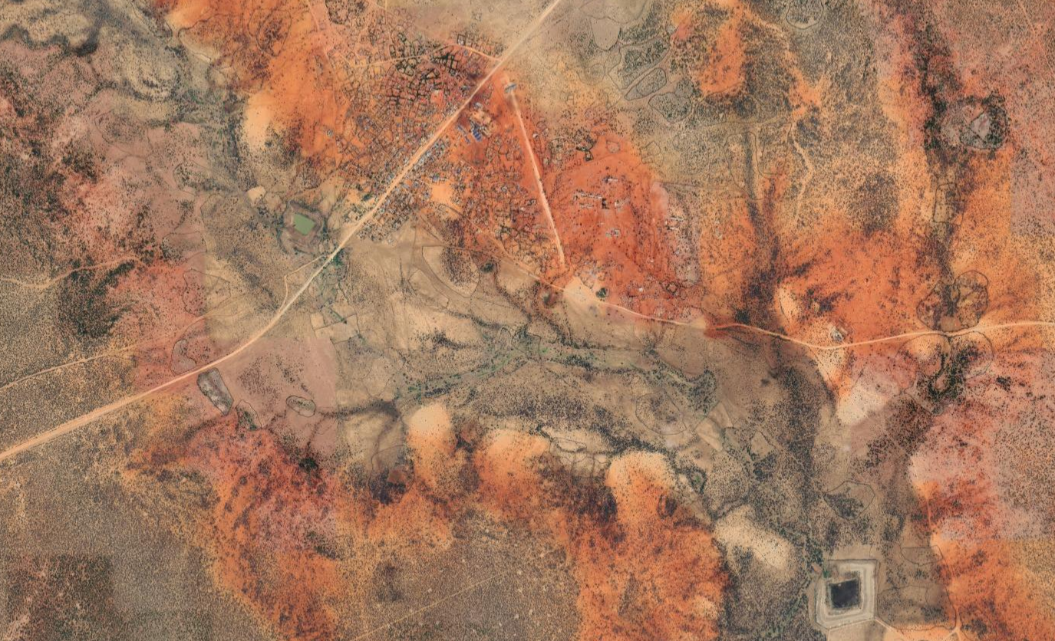
Map in General
Village
FOB
Notes:
Instructor to point out:
FOB Location
Location of the village
Green route which shows the route taken by the patrol on a daily basis – this is approx 6km in total.
The blue triangle representing where the patrol routinely stops for a water break under a shady tree.
The Red triangle represents the location of the recent IED incident.
The blue circle shows the limit of visibility of the FOB sentry positions in the day.
He Red circle shows the limit of visibility of the FOB sentry positions in the night.

Slide 8
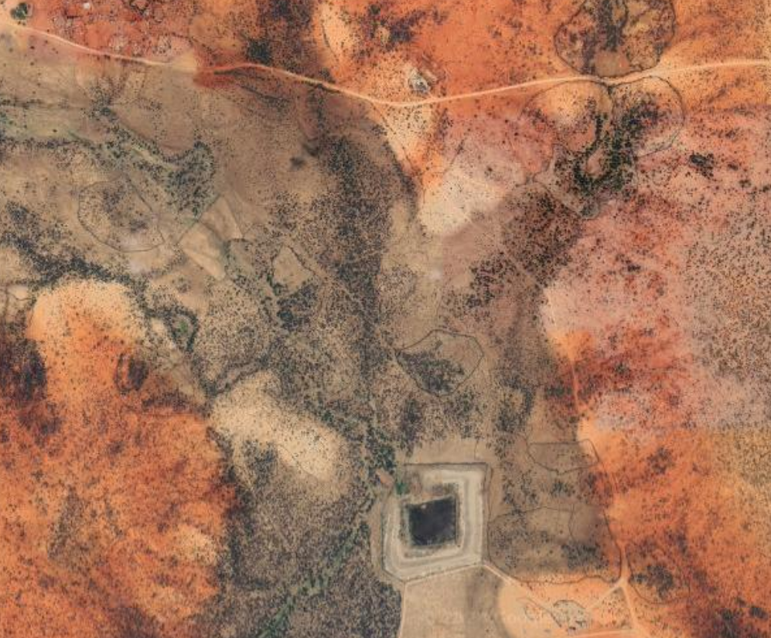


Map in Detail
Notes:
Instructor to point out:
FOB Location
Location of the village
Green route which shows the route taken by the patrol on a daily basis – this is approx 6km in total.
The blue triangle representing where the patrol routinely stops for a water break under a shady tree.
The Red triangle represents the location of the recent IED incident.
The blue circle shows the limit of visibility of the FOB sentry positions in the day.
He Red circle shows the limit of visibility of the FOB sentry positions in the night.

Slide 9
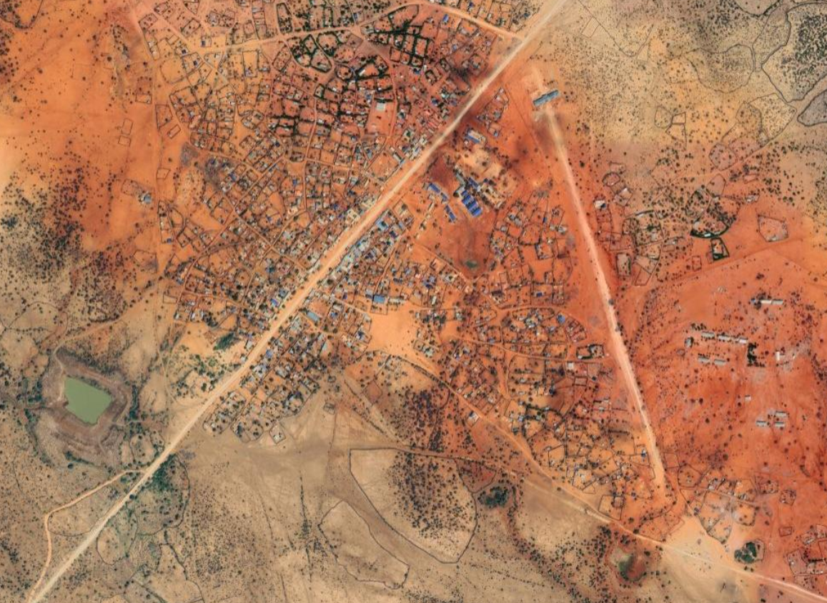
Map in Detail
Notes:
Instructor to point out:
FOB Location
Location of the village
Green route which shows the route taken by the patrol on a daily basis – this is approx 6km in total.
The blue triangle representing where the patrol routinely stops for a water break under a shady tree.
The Red triangle represents the location of the recent IED incident.
The blue circle shows the limit of visibility of the FOB sentry positions in the day.
He Red circle shows the limit of visibility of the FOB sentry positions in the night.

Slide 10
Recent IED Incident
Since the IED incident, civilians have stopped using the main road through the village. This is normally a busy area.
5 Days ago. A UNMIC foot patrol from your Company hit an IED. The IED is believed to be a simple victim operated IED. Components found afterwards suggest the main charge was military ordnance (likely 82mm mortar) and the switch was a pressure plate.
Notes:
Instructor to point out:
FOB Location
Location of the village
Green route which shows the route taken by the patrol on a daily basis – this is approx 6km in total.
The blue triangle representing where the patrol routinely stops for a water break under a shady tree.
The Red triangle represents the location of the recent IED incident.
The blue circle shows the limit of visibility of the FOB sentry positions in the day.
He Red circle shows the limit of visibility of the FOB sentry positions in the night.

Slide 11
Exercise Requirement
As the Search Team Commander you are to carry out a threat assessment and identify possible VAs and VPs.
Your syndicate must, as a minimum;
• Complete the threat assessment using the 6Ws.
• Specifically identify the VPs and VA’s and be able to qualify them. i.e. explain why they are VA’s and VPs.
• Remember to use CAGES to help identify and qualify VPs and VAs.
  Channeling – are there parts of the route which are channeled with no alternative by-pass?
  Aiming Markers – Are there possible aiming markers or linear features to aim along?
  Ground – Does the ground lend itself to an attack?
  Environment – Is there unusual activity?
  Setting Patterns – Have we set a targetable pattern of behaviour?
You have 20 minutes to carry out the assessment. You are to provide a 5-minute brief to the class on your assessment and recommendations.

Slide 12
Threat Assessment Exercise 2
Situation.
You are a member of an insurgency group deployed in CARANA. Your organization is part of a wider terrorist group operating in CARANA seeking to overthrow the legitimate government. Your group has been tasked to cause disruption and inflict casualties on UNMIC forces deploying from a nearby Forward Operating Base (FOB) and gain support from the local population.
In addition to normal vehicle patrols, the UNMIC Forces conducts regular foot patrols through the center of the village to reassure the population and deter your insurgent group from gaining popular support.
The patrols tend to take place in the morning before the heat of the day and late in the evening, they always use the route shown either clockwise or anti clockwise, normally stopping for a water break on route, 5 and 25m checks are conducted whenever they stop. The local population routinely use this same routes in the village area but they do not use the routes near the FOB area.
5 days ago you emplaced an VO IED that was found and neutralized by the UNMIC forces.
You are now required to make up for your previous embarrassment and prove to your commanders that you are able to conduct an effective IED attack.

Slide 13
Map in General
Village
FOB
Notes:
Instructor to point out:
FOB Location
Location of the village
Green route which shows the route taken by the patrol on a daily basis – this is approx 6km in total.
The blue triangle representing where the patrol routinely stops for a water break under a shady tree.
The Red triangle represents the location of your failed IED.
The Green triangle represents the location of raised features.
The blue circle shows the limit of visibility of the FOB sentry positions in the day.
He Red circle shows the limit of visibility of the FOB sentry positions in the night.

Slide 14
Exercise Requirement
As an aggressor you are to carry out a IED attack. You have both command IED (command wire only), victim operated IEDs, and timer devices at your disposal.
Your syndicate must consider:
What type of means of initiation you will use.
What type of main charge
Where will you emplace your device.
When will you emplace the device.
You have 20 minutes to carry out the assessment. You are to provide a 5-minute brief to the class on your assessment and recommendations.

Slide 15

QUESTIONS ?
Notes:
Questions

